Slide 1

JOB SEQUENCING WITH DEADLINES

Slide 2
What is Job Sequencing with deadlines ?
The scheduling of jobs to meet their deadlines while maximizing total profit.
A classic problem in the field of scheduling and optimization.
Sequencing is done on a single processor.

Slide 3
Conditions
You are given a set of jobs.
Each job has a defined deadline and some profit associated with it.
The profit of a job is given only when that job is completed within its deadline.
Only one processor is available for processing all the jobs.
Processor takes one unit of time to complete a job.

Slide 4
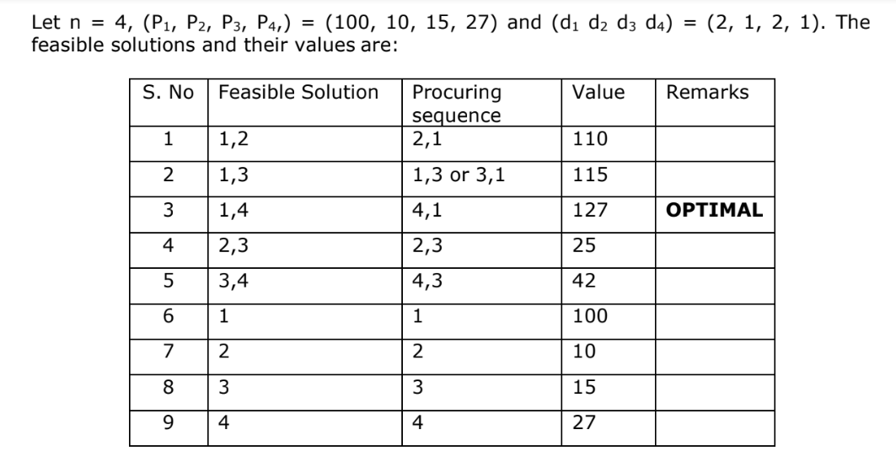
Job Sequencing with deadlines

Slide 5
Algorithm
Sort all jobs in decreasing order of profit.
Iterate on jobs in decreasing order of profit. Allocate slots based on deadlines:
  Place the job with the highest profit in the earliest available slot.
  Ignore jobs if no available slot exists before their deadline.
Time Complexity
Time complexity: O(n²) ,where n is the number of jobs. This complexity arises due to iterating through the jobs and checking available slots.

Slide 6
Problem Statement
As a software engineer how can you maximize the profit if only one job can be completed at a time?
Greedy Method
It’s an greedy method because it makes decision based on locally optimizing immediate gain.
The greedy method involves sorting the jobs in decreasing order of their profit and then placing the jobs one by one in the free slot available just before the deadline to give the maximum profit.

Slide 7
Following are the steps involved:
Jobs | J1 | J2 | J3 | J4 | J5 | J6
Deadlines | 5 | 3 | 3 | 2 | 4 | 2
Profits | 200 | 180 | 190 | 300 | 120 | 100
Jobs | J4 | J1 | J3 | J2 | J5 | J6
Deadlines | 2 | 5 | 3 | 3 | 4 | 2
Profit | 300 | 200 | 190 | 180 | 120 | 100

Slide 8
0 1 2 3 4 5
Step 1
0 1 2 3 4 5
Step 2
0 1 2 3 4 5
 | J4
 | J4 |  |  | J1

Slide 9
Step 3
0 1 2 3 4 5
Step 4
0 1 2 3 4 5
Step 5
0 1 2 3 4 5
J2, J4, J3, J5, J1 is the required order.
 | J4 | J3 |  | J1
J2 | J4 | J3 |  | J1
J2 | J4 | J3 | J5 | J1

Slide 10
Maximum earned profit
= Sum of profit of all the jobs in optimal schedule
= Profit of job J2 + Profit of job J4 + Profit of job J3 + Profit of job J5 + Profit of job J1
= 180 + 300 + 190 + 120 + 200
= 990 units
Summary
  The optimal schedule is: J2 , J4 , J3 , J5 , J1
  This is the required order in which the jobs must be completed in order to obtain the maximum profit.
  All the jobs are not completed in optimal schedule.
  This is because job J6 could not be completed within its deadline.

Slide 11
Code
#include <algorithm>
#include <iostream>
#include <vector>
using namespace std;
// A structure to represent a job
struct Job {
char id; // Job Id
int dead; // Deadline of job
int profit; // Profit if job is over before or on deadline
};
bool comparison(Job a, Job b) {
return (a.profit > b.profit);
}

Slide 12
.
// Returns maximum profit from jobs
void printJobScheduling(Job arr[], int n) {
sort(arr, arr + n, comparison);
int result[n]; // To store result (Sequence of jobs)
bool slot[n]; // To keep track of free time slots
for (int i = 0; i < n; i++)
slot[i] = false;
for (int i = 0; i < n; i++) {
for (int j = min(n, arr[i].dead) - 1; j >= 0; j--) {
if (slot[j] == false) {
result[j] = i; // Add this job to result
slot[j] = true; // Make this slot occupied
break;
}}}

Slide 13
.
for (int i = 0; i < n; i++)
if (slot[i])
cout << arr[result[i]].id << " ";
}
int main() {
int n;
cout << "Enter the number of jobs: ";
cin >> n;
// Create a vector to store jobs
vector<Job> jobs(n);

Slide 14
.
// Input each job's details
for (int i = 0; i < n; i++) {
cout << "Enter details for job " << i + 1 << " (id, deadline, profit): ";
cin >> jobs[i].id >> jobs[i].dead >> jobs[i].profit;
}
cout << "Following is the maximum profit sequence of jobs:\n";
// Convert vector to array for function call (optional step)
Job arr[n];
copy(jobs.begin(), jobs.end(), arr);
// Function call
printJobScheduling(arr, n);
return 0;
}

